Slide 1
SWE 4803
Lec – 9

Slide 2
Closing Process Group

Slide 3
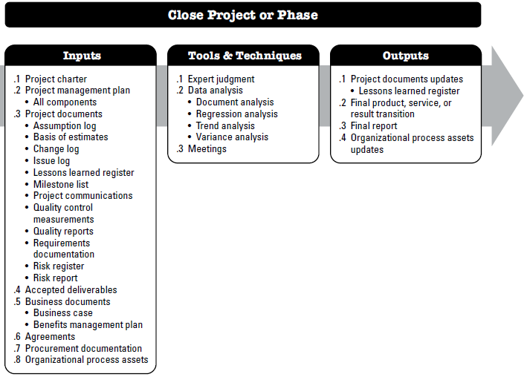
Close Project or Phase
is the process of finalizing all activities for the project, phase, or contract.

Slide 4
Close Project or Phase
Types of Project Closing:
Addition The project is evolved into ongoing operation
Starvation When resources are cut off from the project
Integration People, equipment and other resources are distributed to other area
Extinction Project has been completed and accepted by stakeholders.

Slide 5
Close Project or Phase
Why do we need to close a project:
Successful completion of the project: The project has met all its goals and objectives.
Changes in organizational priorities: The organization's priorities have shifted, and the project is no longer aligned with the new direction.
Lack of funding: The project has run out of funding, and there is no additional budget available to continue the project.
Technological changes: The technology or tools used in the project have become outdated or obsolete, making it impossible to continue with the project.
Failure to meet project goals: The project has failed to meet its goals and objectives, and it is determined that it cannot be recovered.
Legal or regulatory issues: The project is impacted by legal or regulatory issues that make it impossible to continue with the project.
Mergers or acquisitions: The organization is involved in a merger or acquisition that impacts the project's continuation.
External factors: External factors such as natural disasters, political instability, or global pandemics can impact a project's ability to continue.

Slide 6
Close Project or Phase
The project closure process ensures that:
  All work has been completed according to the project plan and scope.
  All project management processes have been executed.
  You have received final sign-off & approval from all parties.

Slide 7
Close Project or Phase
Checklist to ensure your project is successfully completed.
  Formally transfer all deliverables
  Confirm project completion (sign-off & approval)
  Review all contracts and documentation
  Release resources
  Conduct a post-mortem
    Did you stay on budget?
    Did the team members involved manage their time wisely?
    Were there issues with the quality or compromises along the way?
    How closely did the project meet the customer's needs?
    What went well?
    What were the challenges or failures?
    How well did the team communicate?
    Did the team follow the outlined processes and plan?
    Was the client satisfied with the results?
    What would you change or improve for future projects?
  Archive documentation
  Celebrate

Slide 8
Close Project or Phase
Input:
Everything related to the project including the activities/interactions related roles and responsibilities of project team members and stakeholders

Slide 9
Close Project or Phase
Tools & Techniques:
Expert Judgement
Data Analysis
Meetings

Slide 10
Close Project or Phase
Output:
Final product, service, or result transition
Final Report
Project doc update
  Lessons learned register
OPA updates

Slide 11
Sample Question
You are a project manager of animation production house. Your company specializes in producing animation films for kids. Your last project has just been canceled due to budget cuts. What kind of project ending is this?

Slide 12
The End of the Beginning

Slide 13
Professional Ethics for Project Managers

Slide 14
What causes some people to behave ethically and some not?
I have no choice.
It was part of my job and expected in this line of work
It was a direct order so what else could I do? There were not other options.
It was beyond my control. I can’t control what others do once it’s out of my hands.
I may not like it, but I’ll do it until I can get out of this situation.
The customer expects it and management keeps putting on pressure to get the job done, no matter what it takes
In the overall scheme of things, I don’t think it really matters.
Everyone else does it, why shouldn’t I? I deserve it too!
if no one else gets hurt, what’s the harm?
No one else cares so why should I?
I know what I did was wrong, but I’ll make up for it in other ways. Besides no one will probably even notice.

Slide 15

Process Tailoring
Do all the processes apply to all the projects all the time?

Slide 16
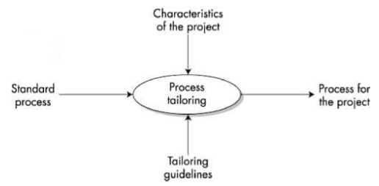
Process Tailoring
No defined process
Tailoring is the process of adjusting a previously defined process of an organization to obtain a process that is suitable for the business or technical needs of a project.

Slide 17
Assess the Process Tailoring Needs
Each project is unique, so you should develop a list of questions to best fit your project.
Few examples:
• Is this a phased project and if so, how many phases will this project have?
• What is the size / complexity of the project and how will it impact the project management plan?
• Will we use Agile or Waterfall?
• Are the project requirements clearly or loosely defined?
• Does the project need to be fast tracked?
• Are there any regulatory quality requirements that impact this project?
• Are required skills available in-house to complete this project or will resources need to be hired?
• Will the project team be co-located or virtual?
• Have they worked together previously?
• Will project team members be allowed to directly communicate with stakeholders or will all communication need to go through the project manager?
• What would be the impact to the organization if the project were to fail?
• Will the project management team have the authority to sign contracts or will this be done by a procurement or legal department?
• What level of approval will the project team have for purchases ($100, $1,000, $10,000, etc.)?
• Are the Stakeholders physically located near the project?

